Slide 1

Geometry
Unit 5, Lesson 9 Congruence in Two-Dimensional Figures – Part 1 Volume 1, pg. 272

Slide 2


Benchmark
MA.912.GR.1.6 Solve mathematical and real-world problems involving congruence or similarity in two-dimensional figures.
volume 1, pg. 272

Slide 3
Integrated Mathematical Thinking and Reasoning Standards
MA.K12.MTR.1.1 Actively participate in effortful learning both individually and collectively.
MA.K12.MTR.3.1 Complete tasks with mathematical fluency.
MA.K12.MTR.4.1 Engage in discussions that reflect on the mathematical thinking of self and others.
MA.K12.MTR.5.1 Use patterns and structure to help understand and connect mathematical concepts.
volume 1, pg. 272

Slide 4

Learning Target
I can solve mathematical problems involving congruence.
volume 1, pg. 272

Slide 5

Warm-Up
volume 1, pg. 272

Slide 6
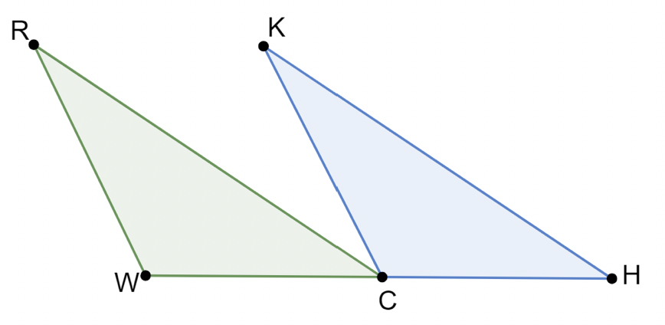

5.9.1 Warm-Up: Bell Work
Triangles $RCW$ and $KHC$ are shown.
Given: $RW∥KC$, $C$ is the midpoint of $\overline{WH}$, $\overline{WR}≅\overline{CK}$
Prove:$∠WRC≅∠CKH$
volume 1, pg. 272

Slide 7
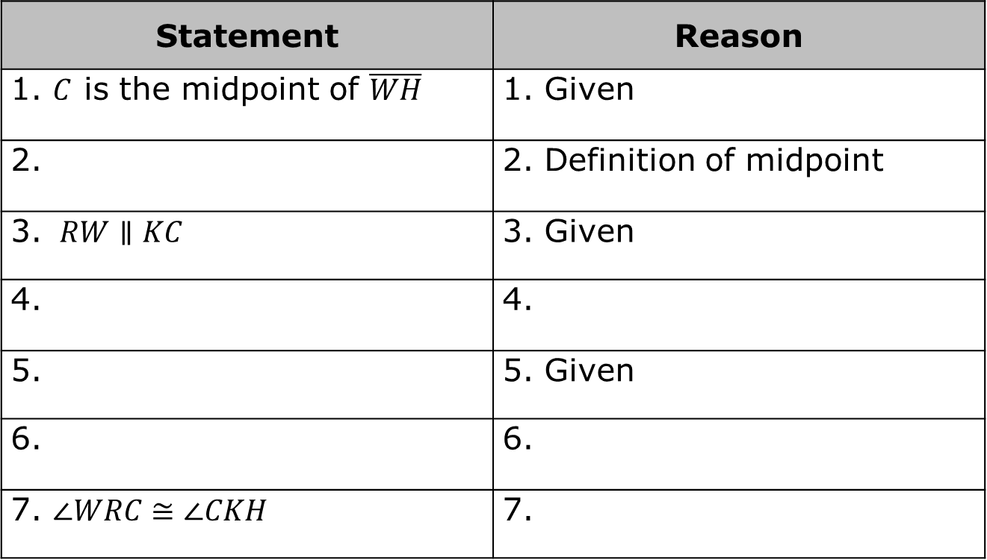
Complete the missing statements and reasons in the two-column proof.
Statement | Reason
1. $C$ is the midpoint of $\overline{WH}$ | 1. Given
2. | 2. Definition of midpoint
3. $RW∥KC$ | 3. Given
4. | 4.
5. | 5. Given
6. | 6.
7. $∠WRC≅∠CKH$ | 7.
volume 1, pg. 272

Slide 8

Collaboration
volume 1, pg. 273

Slide 9

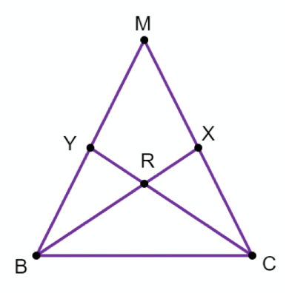
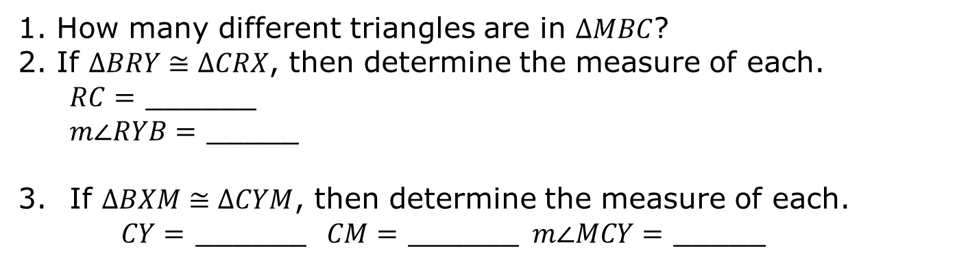
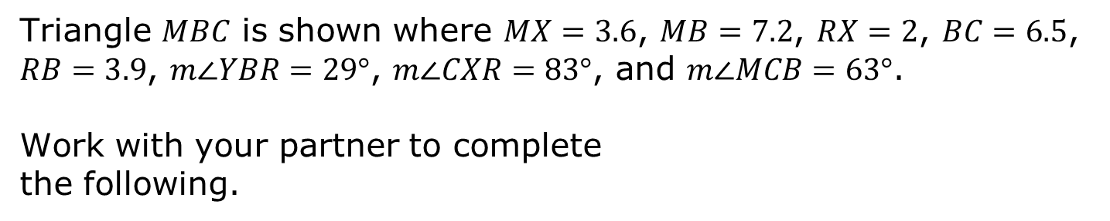
5.9.2 Collaboration: Using CPCTC to Determine Measures
Triangle $MBC$ is shown where $MX=3.6$, $MB=7.2$, $RX=2$, $BC=6.5$, $RB=3.9$, $m∠YBR=29°$, $m∠CXR=83°$, and $m∠MCB=63°$.
Work with your partner to complete
the following.
How many different triangles are in $∆MBC$?
If $∆BRY≅∆CRX$, then determine the measure of each.
$RC=$ ______
$m∠RYB=$ _____
If $∆BXM≅∆CYM$, then determine the measure of each.
$CY=$ ______ $CM=$ ______ $m∠MCY=$ _____
volume 1, pg. 273

Slide 10

Guided Instruction
volume 1, pg. 273

Slide 11

5.9.3 Guided Instruction: Corresponding Parts of Congruent Polygons
Any polygon that can be mapped to another polygon using rigid transformations shows that all of the parts of the polygons are congruent. This understanding can then be applied to find measurements of the two congruent polygons.
Corresponding Parts of Congruent Polygons are Congruent
If two polygons are congruent, then all corresponding parts of the polygons are congruent.
volume 1, pg. 273

Slide 12
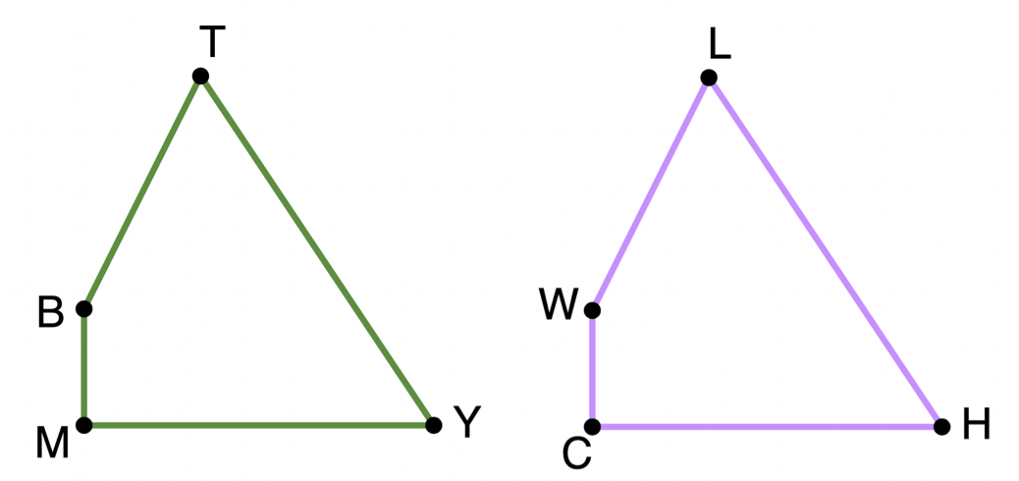
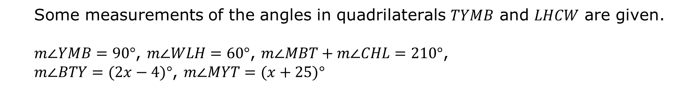
Congruent quadrilaterals $TYMB$ and $LHCW$ are shown.
Some measurements of the angles in quadrilaterals $TYMB$ and $LHCW$ are given.
$m∠YMB=90°$, $m∠WLH=60°$, $m∠MBT+m∠CHL=210°$,
$m∠BTY=(2x−4)°$, $m∠MYT=(x+25)°$
volume 1, pg. 273

Slide 13

Determine each.
$$m∠BTY$$
$m∠CWL$
Some measurements of the sides of quadrilaterals $TYMB$ and $LHCW$ are given.
$HC=5k$, $LW=4k−0.5$, $YT=6k$, and $BM=k+1$.
volume 1, pg. 274

Slide 14
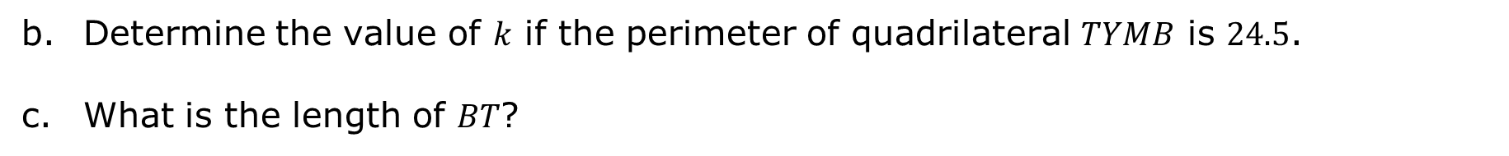
Determine the value of $k$ if the perimeter of quadrilateral $TYMB$ is $24.5$.
What is the length of $BT$?
volume 1, pg. 274

Slide 15
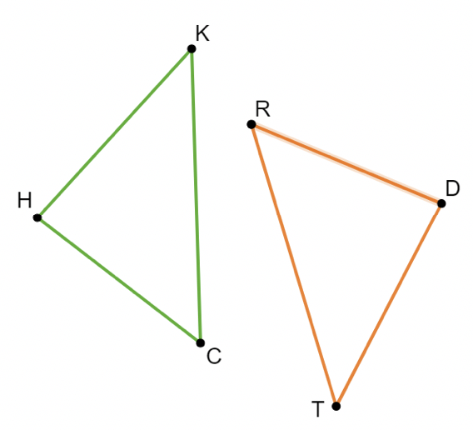
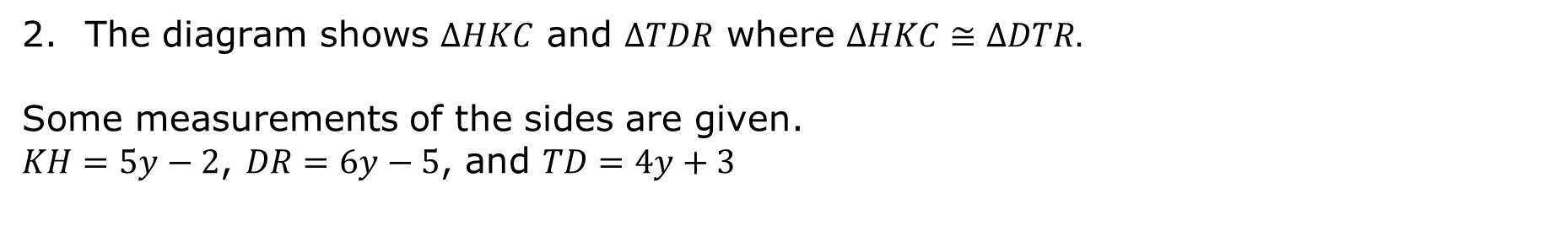
The diagram shows $∆HKC$ and $∆TDR$ where $∆HKC≅∆DTR.$
Some measurements of the sides are given.
$KH=5y−2$, $DR=6y−5$, and $TD=4y+3$
volume 1, pg. 274

Slide 16
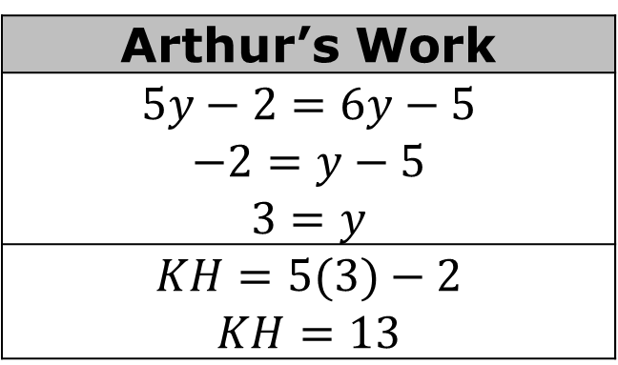
Arthur used the information to determine the length of$KH$. His work is shown.
Find Arthur’s error.
Arthur’s Work
$$5y−2=6y−5$$ $$−2=y−5$$ $$3=y$$
$$KH=5(3)−2$$ $$KH=13$$
volume 1, pg. 274

Slide 17
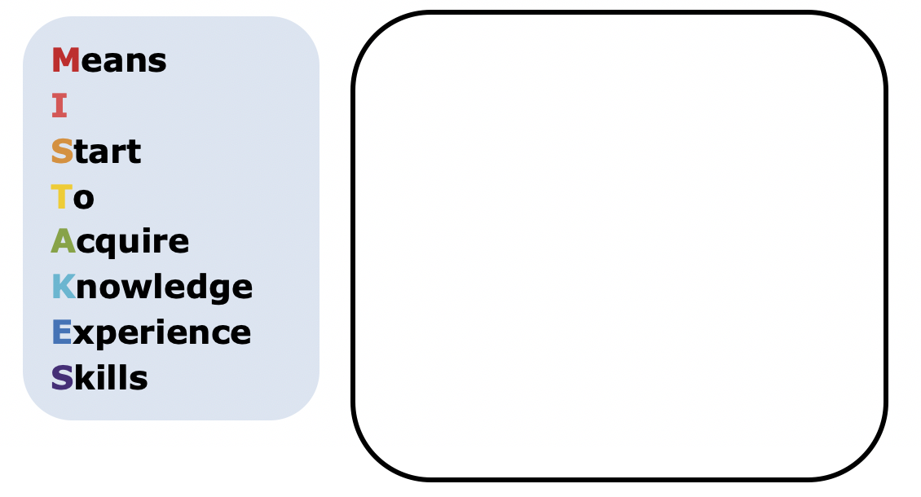
Help Arthur understand and learn from his mistake. Write a brief note to Arthur explaining what his mistake was and how he can learn from the mistake.
volume 1, pg. 274

Slide 18

Guided Practice
volume 1, pg. 275

Slide 19

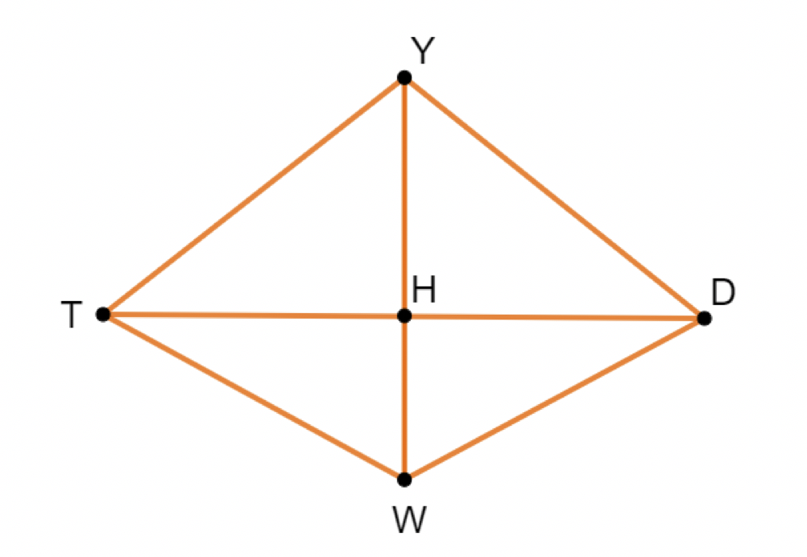
5.9.4 Guided Practice: Corresponding Parts
Quadrilateral $YDWT$ is shown where $\overline{YH}$ is a perpendicular bisector of $\overline{TD}$.
volume 1, pg. 275

Slide 20
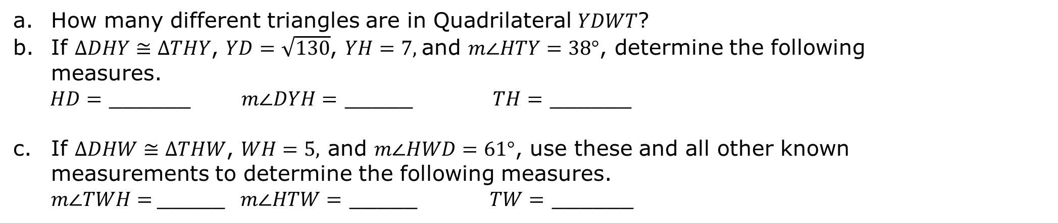
How many different triangles are in Quadrilateral $YDWT$?
If $∆DHY≅∆THY$, $YD=\sqrt{130}$, $YH=7,$and $m∠HTY=38°$, determine the following measures.
$HD=$ ______ $m∠DYH=$ _____ $TH=$ ______
If $∆DHW≅∆THW$, $WH=5,$ and $m∠HWD=61°$, use these and all other known measurements to determine the following measures. $m∠TWH=$_____ $m∠HTW=$ _____ $TW=$ ______
volume 1, pg. 275

Slide 21
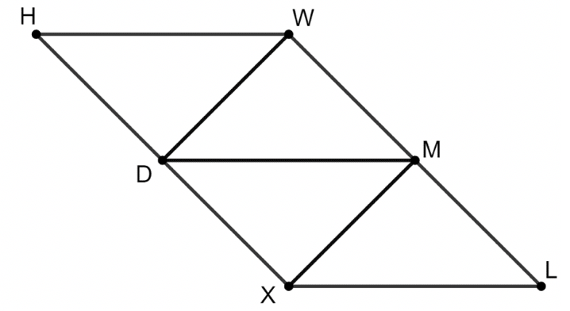

Quadrilateral $HWLX$ is shown.
$HWMX≅LXDW$ and $∆XMD≅∆WDM$. The perimeter of $HWMX$ is $40.5$.
Use the given measurements to find the value of $x$.
$HW=2x−2$, $XD=\frac{3}{2}x−1$, $HX=2x+5$, $WD=2x−2$
Find the length of $MX$.
volume 1, pg. 275

Slide 22

Wrap-Up
volume 1, pg. 276

Slide 23
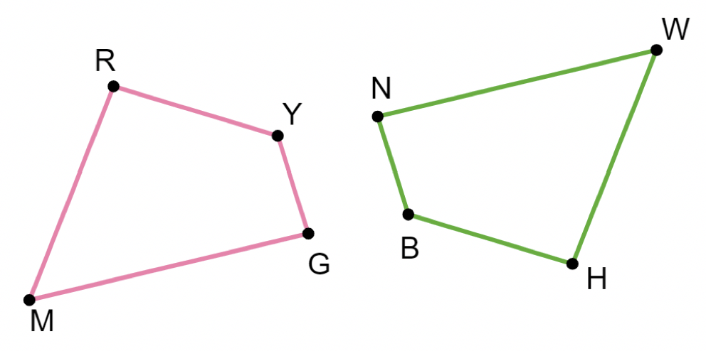

5.9.5 Wrap-Up: Error Analysis
Quadrilaterals $RYGM$ and $HBNW$ are shown.
volume 1, pg. 276

Slide 24
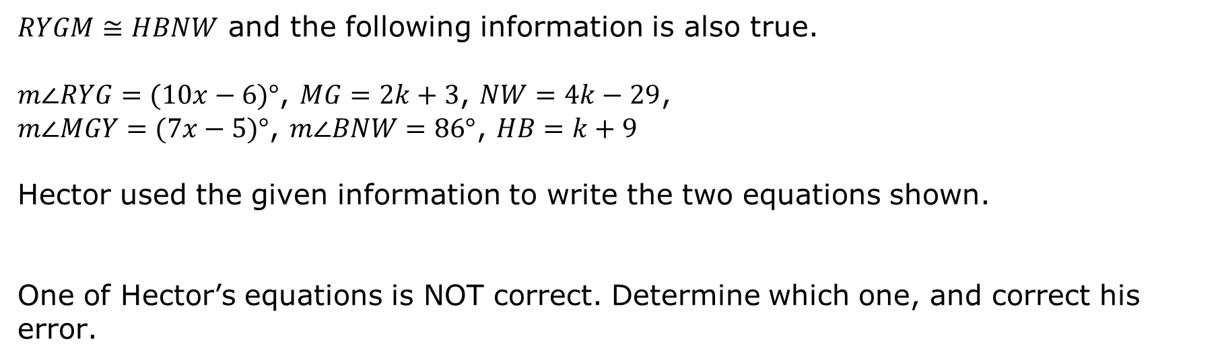
$RYGM≅HBNW$ and the following information is also true.
$m∠RYG=(10x−6)°$, $MG=2k+3$, $NW=4k−29$,
$m∠MGY=(7x−5)°$, $m∠BNW=86°$, $HB=k+9$
Hector used the given information to write the two equations shown.
One of Hector’s equations is NOT correct. Determine which one, and correct his error.
$$10x−6=86$$ | $$4k−29=2k+3$$
volume 1, pg. 276

